Slide 1
Exploring the boroughs of london
Ibm data science certification – final report

Slide 2
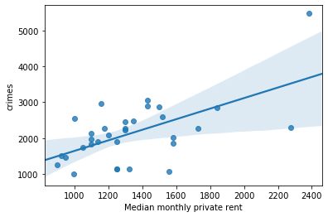
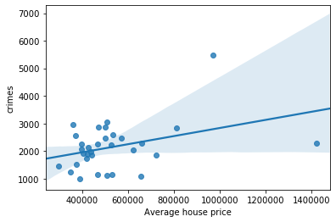
Price – crime
A positive linear connection between housing price and the number of crimes in the boroughs of London.

Slide 3
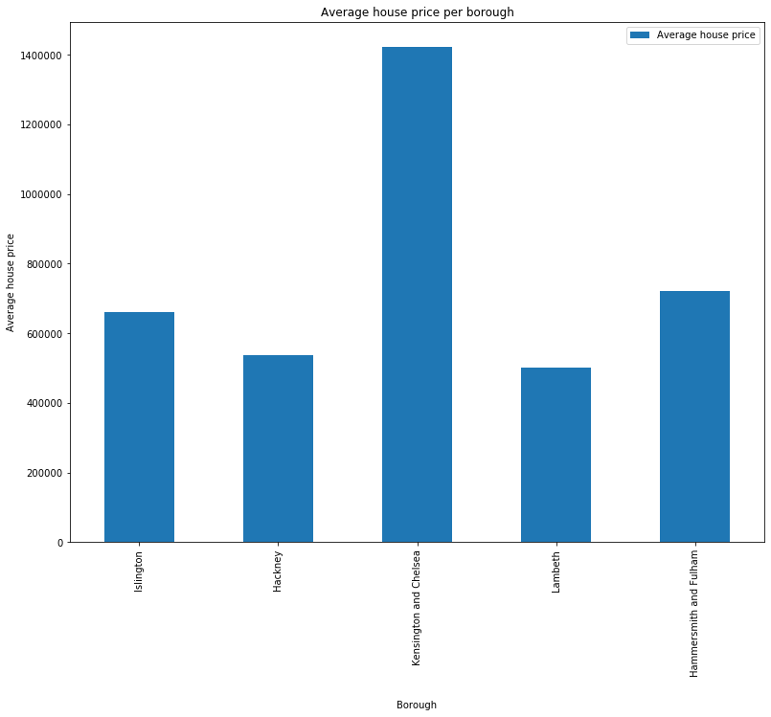
Average house price per borough
The top 5 most crowded boroughs of London:
Islington
Hackney
Kensington and Chelsea
Lambeth
Hammersmith and Fulham

Slide 4
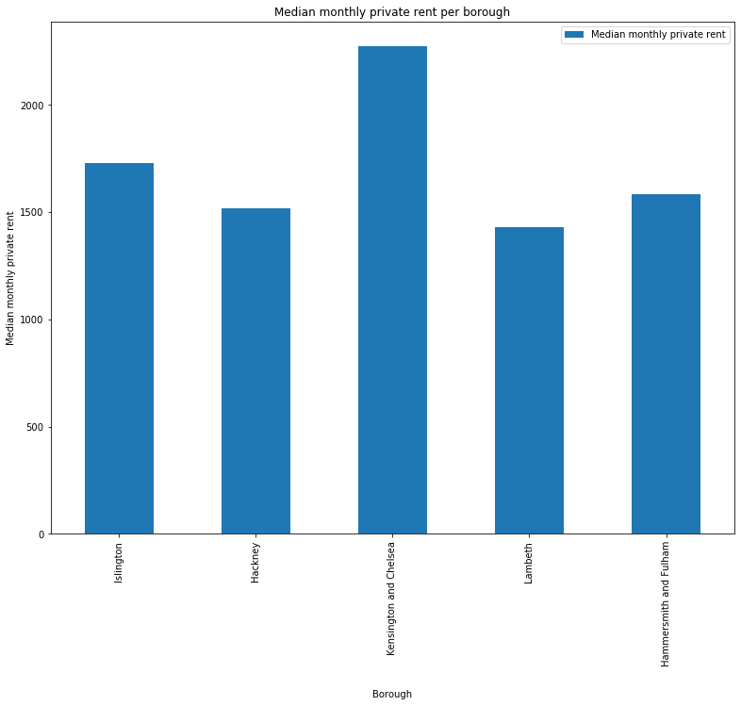
Median monthly private rent per borough
We can see which boroughs are more expensive than the others, out of the top 5 boroughs in London

Slide 5
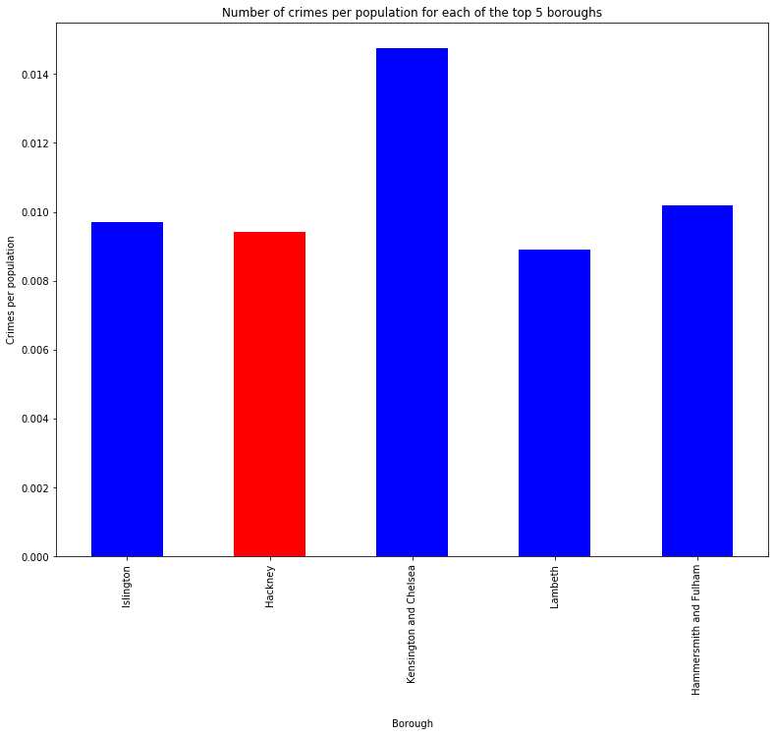
Crimes per population per borough
We can see which boroughs has more crimes considering it’s population number, than the others,
out of the top 5 boroughs in London

Slide 6
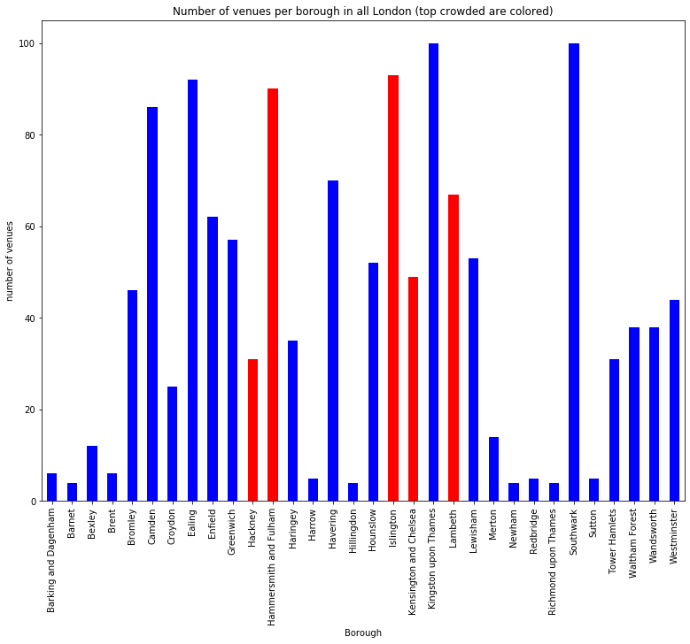
Number of venues per borough
This time in all London.
The top 5 boroughs are highlighted in red.

Slide 7
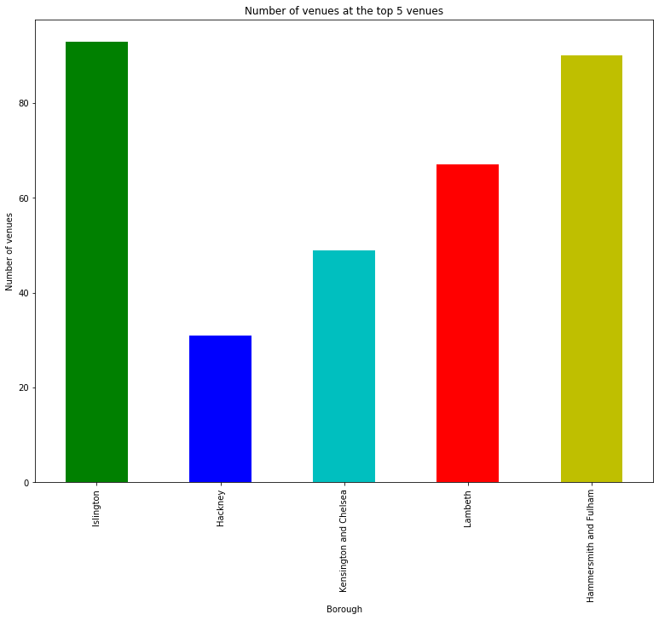
Number of venues per borough
This time focusing the top 5 boroughs.
Hackney’s lack of venues is notable.

Slide 8
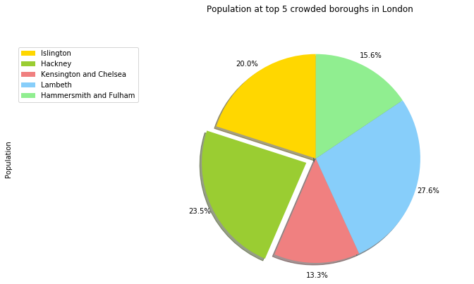
Population per borough
This time focusing the top 5 boroughs.
Hackney is the second most populated borough out of the top 5.

Slide 9
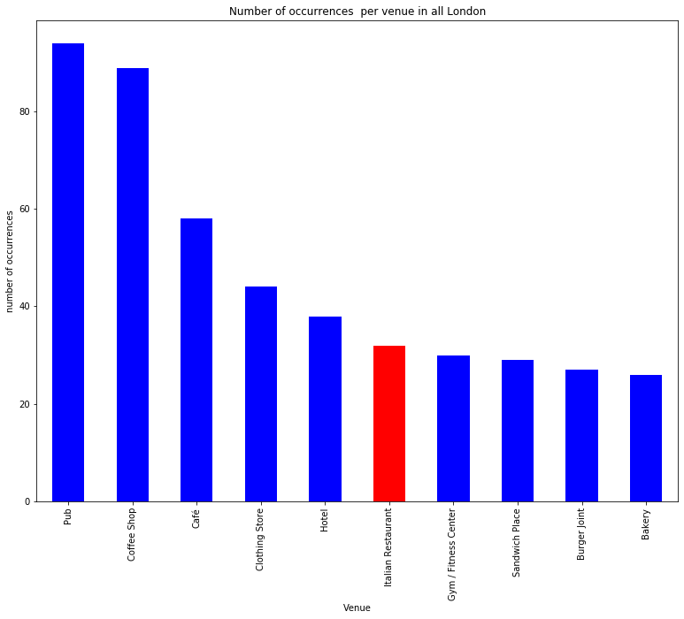
Most frequent venue categories
Most frequent venues in Hackney:
Coffee shop
Pub
Vietnamise restaurant
Bar
Café
Italian restaurant might be a good match for Hackney.

Slide 10
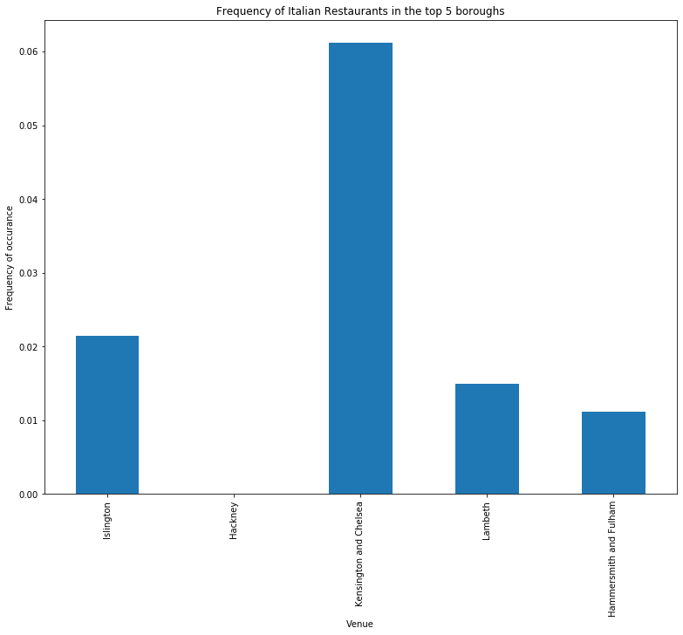
Frequency of Italian restaurants per borough
Hackney has no Italian restaurants at all !

Slide 11
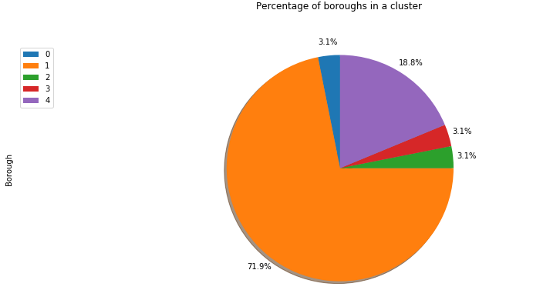
Number of boroughs per cluster
After performing K-Means Machine Learning algorithm, we could cluster the boroughs of London.

